Slide 1
The 18th Annual Family Café
Welcome to the
Agency for Persons with Disabilities
TRAIN Florida
Presentation
Powered by
The Agency for Persons with Disabilities
Notes:
Slide 1 – Introduction Slide
Good Afternoon!
Welcome to the Agency for Persons with Disabilities TRAIN Florida Presentation.
Thank you for your interest in TRAIN Florida.
Beginning May 18, 2016, TRAIN Florida became the official Learning Management System (LMS) for the Agency for Persons with Disabilities (APD).

Slide 2
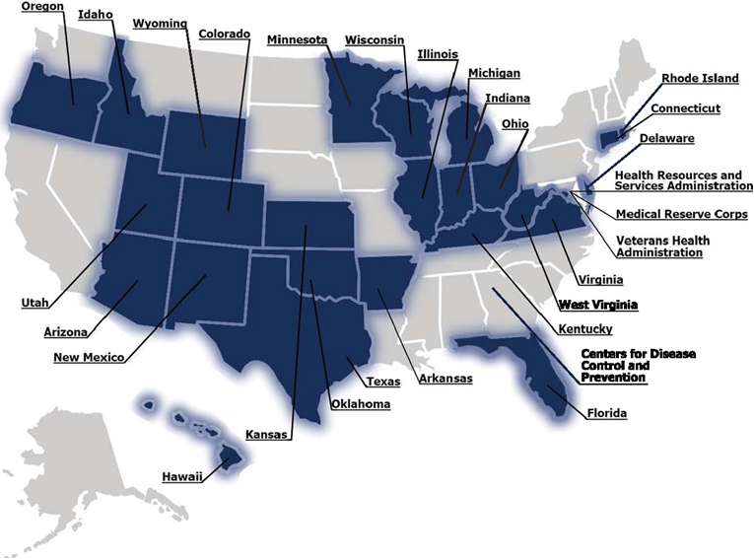
Introduction to TRAIN National
The TRAIN Learning Management Network
Notes:
Slide 2– Introduction to Train Florida – Part 1
The TRAIN Florida learning management network is currently comprised of 29 affiliates, which include 25 state agencies and four federal partners -the Centers for Disease Control and Prevention (CDC), the Medical Reserve Corps (MRC), the Health Resources and Services Administration (HRSA), and the Veterans Health Administration (VHA). These affiliates link to the national TRAIN network and form the crux of the TRAIN Community. With more than 900,000 registered learners and nearly 4,000 course providers, TRAIN is the go-to workforce development resource.
2

Slide 3
TRAIN Florida - APD's Learning Management System
APD’s New Training Portal Network
APD is onboard TRAIN Florida
Notes:
Slide 3 – Welcome to the Train Florida - APD's Learning Management System
The APD is pleased to announce the TRAIN Florida Learning Management System (LMS). TRAIN Florida is part of a national public health learning management network managed by the Public Health Foundation. The new LMS will provide employees, support staff, families, and direct care staff with a web-based learning system. The TRAIN Florida LMS will allow each learner to interact with other state and federal agencies, local and national organizations, educational institutions, and our community partners.
We are excited about this opportunity to provide our APD online and classroom trainings, create a network for sharing training, resources and information, as well as specialized trainings at a significant reduced cost.
3

Slide 4
What TRAIN National Offers
The TRAIN Florida Learning Management
Network
37,000 National Courses
Access to Data Analytics
Workforce Development Needs
Network for Sharing Training
Continuing Education
Creates a system network for sharing training content, resources and information
Notes:
Slide 4 – What TRAIN National Offers
TRAIN is a cost effective web-based learning management system that benefits our workforce by providing:
Access to more than 37,000 national courses
Access to the TRAIN Florida Data Analytics to help generate training reports.
Workforce development needs based on professional competencies
A system network for sharing public health training resources, and
Continuing education courses for licensed professionals
Our goal for TRAIN Florida is to provide a user-friendly enterprise to aid in developing and sustaining a competent and qualified workforce, and to create a system network for sharing training content, resources and information throughout Florida.
4

Slide 5
What TRAIN Florida Offers
TRAIN Florida offers practical solutions
Manage educational content
Deliver information content
Track learning, and communicate with learners
Standardize training and curriculum
The TRAIN Florida structure design offers the necessary access and tools specific to three types of users: Learners, Course Providers, and Administrators.
Notes:
Slide 5 – What Train Florida Offers
TRAIN Florida offers the following practical solutions:
APD will be able to:
Standardize and manage educational content – provide consistency
Effectively deliver information and training content,
Effectively manage and track learning, and communicate with learners.
Standardize training and curriculum
5

Slide 6
What TRAIN Florida Offers
Providers
Track learning, and communicate with staff
Deliver information content
Manage educational content for staff
Track transcripts and certifications
.
Notes:
Slide 6– What Train Florida Offers
APD Providers will be able to:
Manage educational content for staff
Track certifications
Effectively deliver information and training content,
Effectively manage and track learning, and communicate with staff.
6

Slide 7
APD Benefits from using TRAIN Florida
What Will TRAIN Florida Do For APD?
Long term and immediate workforce development needs
Managers and staff can identify, register for and track trainings
Network for sharing training and access to APD trainings free
Provides the infrastructure for short- and long-term provider and customer training
Oversight and management of an organization’s learners, courses and continuing education
Tracking and sharing valuable training data via powerful reporting portal
Notes:
Slide 7 – APD Benefits from using TRAIN Florida
What Will TRAIN Florida Do for APD?
Long term and immediate workforce development needs
Managers and staff can identify, register for and track trainings
Network for sharing training and access a variety of trainings at a reduced cost
Provides the infrastructure for short and long term provider and customer training
Oversight and management of an organization’s learners, courses and continuing education
Tracking and sharing valuable training data via powerful reporting portal
7

Slide 8
APD Benefits from using TRAIN Florida
How do I register for TRAIN Florida?
If you are a provider or employee with the Agency for Persons with Disabilities:
PLEASE DO NOT CREATE A TRAIN FLORIDA LEARNER ACCOUNT
You must have a valid email account
The TRAIN Florida APD LMS support team creates your TRAIN Florida learner account for you.
Notes:
Slide 8 – APD Benefits from using TRAIN Florida
How do I register for TRAIN Florida?
If you are a provider or employee with the Agency for Persons with Disabilities:
PLEASE DO NOT CREATE A TRAIN FLROIDA LEARNER ACCCOUNT
You must have a valid email account
The TRAIN Florida APD LMS support team creates your TRAIN Florida Learner account for you.
All providers with a valid email address received an email on May 18, 2016, with their login information. All new learners will be sent an account creation confirmation email from TRAIN Florida, with their login name and password. We strongly encourage you to read the email, and review the instructions, to help guide you through the initial log in to TRAIN Florida. During this process you will review, verify, and if needed, update the entered account information.
New Providers
All new providers will receive an account creation confirmation email from TRAIN Florida, with your login name and password.
8

Slide 9
APD Benefits from using TRAIN Florida
How do I register my staff?
PLEASE DO NOT CREATE A TRAIN FLORIDA LEARNER ACCOUNT
TRAIN Florida Learner Batch Upload spreadsheet
TRAIN Florida APD Group structure
The TRAIN Florida APD LMS support team creates your TRAIN Florida learner account for you.
Notes:
Slide 8 – APD Benefits from using TRAIN Florida
How do I register for TRAIN Florida?
PLEASE DO NOT CREATE A TRAIN FLORIDA LEARNER ACCOUNT
TRAIN Florida Learner Batch Upload spreadsheet
TRAIN Florida APD Group structure
The TRAIN Florida APD LMS support team creates your TRAIN Florida Learner account for you.
All providers with a valid email address should have received an email on May 18, 2016 with their login information. All new learners will be sent an account creation confirmation email from TRAIN Florida, with their login name and password. We strongly encourage your staff to read the email, and review the instructions, to help guide them through the initial log in to TRAIN Florida. During this process they will review, verify, and if needed, update the entered account information.
The TRAIN Florida APD support team will create the accounts for APD provider staff, using information you provide for us. You will receive the following:
New Providers
All new providers will receive an account creation confirmation email from TRAIN Florida, with their login name and password.
9

Slide 10
APD Provider and Customer Training?
APD Provider and Customer Trainings
Three types of APD Provider Trainings
Required Provider Basic Training
Required Provider Service-Specific Training
Required Provider In-Service Training
Notes:
Slide 10 – APD Provider and Customer Training
Providers and customers can access various APD training web pages for information about training requirements and opportunities.
Although specific training is required for providers and some APD employees, these courses are available to everyone—including APD customers and family members.
There are three types of APD trainings: Required Provider Basic Training (applies to all direct care staff), Required Provider Service-Specific Training (applies to direct care staff of specific services) and Required Provider In-Service Training. Some of these courses are available using web-based training, some are available in a classroom setting and some are available in both settings. The web-based courses require a fee while the classroom courses from APD are free.
APD also provides information about Web-based courses and registration for courses not taught by APD
10

Slide 11
APD Provider and Customer Training?
APD Provider and Customer Trainings
APD Trainings on TRAIN FLORIDA
Zero Tolerance
Direct Care Core Competencies
HIPAA
Notes:
Slide 10 – APD Provider and Customer Training
The first APD courses you must register for and complete in TRAIN Florida are:
APD – Zero Tolerance – A Statewide Initiative
APD – Direct Care Core Competencies (DCCC)
ADP – Health Insurance Portability and Accountability Act (HIPAA)
Direct Care Core Competencies includes; Individual Choices, Rights, and Responsibilities; Introduction to Developmental Disabilities; Maintaining Health, Safety, and Wellness; and Basic Person Centered Planning. All providers are required to complete the course “Requirements for All Waiver Providers” located on the APD website at http://apdcares.org/providers/training/required-basic-training.htm.
NOTE: Once you complete the courses in TRAIN Florida, the courses will automatically be posted to your TRAIN Florida transcript.
Providers and customers can access various APD training on TRAIN Florida for free.
11

Slide 12
APD Training Solutions?
Closing APD Training Gaps
APD Training Analysis:
Strengths
Weaknesses, and
Opportunities
APD Training Solutions: Closes the GAPS
Encouraging
Enabling
Engaging, and
Empowering
Notes:
Slide 11 – APD Training Solutions
APD has identified our training strengths, weaknesses, and opportunities.
Our performance measures provide solutions for closing our training gaps and include; encouraging, enabling, engaging and empowering our providers and customers through a powerful Learning Management System.
12

Slide 13
TRAIN Florida - Demo
TRAIN Florida Demonstration
The TRAIN structure offers access & tools to: Learners, Course Providers & Administrators
Learners, Course Providers and Administrators
Available 24/7
Notes:
Slide 12 –Train Florida Demo
The TRAIN structure offers access and tools to:
Learners, Course Providers, and Administrators
It is available 27/4 and supports various web browsers.
APD learners will have access to the TRAIN Login page from various APD external web pages.
Let’s take a few minutes and see TRAIN Florida in action – (click TF logo to access login page)
13

Slide 14
The Value of APD in TRAIN Florida
The Value of APD in TRAIN Florida
Qualified Workforce
Economies of Scale
+ Power in Numbers
PRICELESS
The TRAIN has arrived to the Agency for Persons with Disabilities! Get on board today!
Notes:
Slide 13 – The Value of APD participating in TRAIN Florida
What is the value of APD participating in TRAIN Florida?
The value can be seen in developing a qualified workforce as you and your staff gain access to more than 29,000 educational trainings. This in turn becomes a strong tool for helping to sustain a competent and qualified organization.
Economies of Scale: Participation in TRAIN Florida supports APD training at a significant cost savings. It does so by strengthening the Core Competencies in a workforce empowered by a vibrant, cost effective, easy to use learning system.
This Power in Numbers is Priceless.
14

Slide 15
Additional Information
The TRAIN has arrived to the Agency for Persons with Disabilities!
Contact:
If you have any questions regarding TRAIN Florida, contact the TRAIN Florida APD TRAIN Florida Support Team by email at apd.lmssupport@apdcares.org.
Please do not contact the Public Health Foundation (PHF) or the Florida Department of Health (DOH) regarding TRAIN Florida website questions.
Notes:
Slide 14 – Additional Information
The TRAIN has arrived to the Agency for Persons with Disabilities! Get on board today!
Want to learn more about APD coming onboard TRAIN Florida?
Contact:
If you have any questions regarding TRAIN Florida, contact the TRAIN Florida APD TRAIN Florida Support Team by email at apd.lmssupport@apdcares.org.
Please do not contact the Public Health Foundation (PHF) or the Florida Department of Health (DOH) regarding TRAIN Florida website questions.
15

Slide 16
Additional Information
QUESTIONS?
Notes:
Slide 15 – Additional Information
Questions?
16

Slide 17
The 18th Annual Family Café
Thank You!
Powered by
The Agency for Persons with Disabilities
Notes:
Slide 16 – Last Slide
Thank you for attending this presentation

