Slide 1
Reactive Strategies Tracking and COVID-19: A Review
Kristin Korinko, Ph.D., BCBA, LMHC, NCC
Ron DeSantis
Governor
Barbara Palmer
Director

Slide 2
Description
Discussion of the impact of the COVID-19 pandemic on intervention strategies.
Discussion of current reactive strategy reporting protocols to ensure that effective and "least restrictive" methods.
Discussion of identified recent trends in potential COVID-19-related contingencies/environmental controls and the changes in outcome data as they relate to reactive strategy implementation.

Slide 3
Learning Objectives
1) Identify behavior analytic principles applicable to reactive strategy applications.
2) Identify the functions/correlations between potential COVID-19-related contingencies/environmental controls and the changes in outcome data as it relates to reactive strategy implementation.
3) Update reactive strategy report templates with COVID-19- related features.

Slide 4
Reactive Strategy Rule 65G-8
Procedures and prohibitions outlined in Rule
“Last resort”
Appropriate documentation from providers
Monthly report is sent to Senior Behavior Analyst/LRC Chairperson per the region as appropriate.
The monthly report is then followed up by the APD/SBA.
The monthly report is then sent to State Office (Amanda/Kristin).

Slide 5
Frequently Asked Questions…
What will the COVID-19 pandemic (COVID-19) do to our practice of Reactive Strategies?
How will we implement Reactive Strategies and train staff during this pandemic (social distancing restrictions)?
Which contingencies that have been put in place in response to the COVID-19 pandemic will affect the efficacy of ABA intervention strategies?
Which contingencies could result in implementation of a reactive strategy?
Is quarantine the same as seclusion?

Slide 6
COVID-19-related Reactive Strategies Reporting Form Update
The COVID-19 pandemic may impact the use of Reactive Strategies, such as:
Social/physical distancing (e.g., staying at least 6 feet away from others in the community)
Self-isolation/quarantining (e.g., for those who display possible COVID-19 symptoms, test positive for COVID-19, or are immunocompromised)
Denied access to preferred reinforcers:
Items (e.g., food, toys, video games, name-brand toilet paper)
Activities (e.g., concerts, sporting events, games)
Social interactions (high fives, hugs, fist bumps, visiting with friends, seeing classmates)
Consistent schedules (e.g., activities, food, bus, medical/dental appointments, school)
Trauma (e.g., someone they know is ill and/or has passed away)
Lack of available resources (e.g., caregiver, employment, toilet paper, food, residence, transportation)

Slide 7
COVID-19-related Reactive Strategies Reporting Form Update
Examples:
Johnny wants to go play in the park. When staff members told him that due to social-distancing restrictions he cannot go to the park, he hit them repeatedly, requiring staff members to use manual restraint to safely deescalate the event.
Marco usually goes his favorite grocery store every day after work. He usually gets off from work at 7:00 PM. Now, due to the stay-at-home order in his city, he doesn’t have time after work to make an additional stop at the grocery store. When his staff point this out to him, he elopes from supervision. Staff attempt to follow him but are unable. Marco has been deemed by the court system to be incompetent. Therefore, law enforcement needed to be contacted to locate and return him.
Bertie rides the bus to volunteer at the animal shelter on Mondays, Wednesdays, and Fridays from 9:00 AM to 11:00 AM. On those days, she knows that she must be at the bus stop at 8:30 AM in order to arrive on time. The bus schedule is different now due to COVID-19 restrictions and no longer stops at her stop at 8:30 AM. This means she will have to change her volunteer schedule if she wants to continue volunteering. She doesn’t want to change her schedule because she will miss her favorite soap operas, which start at noon. When she is told by her staff that she may have to change her schedule, she runs out into the busy road with cars traveling in both directions. Her staff implement a manual restraint in the form of a transport hold to move her out of the dangerous situation.

Slide 8
COVID-19-related Reactive Strategies Reporting Form Update
Examples:
Quinn eats Doritos for her snack daily. The group home is now out of Doritos due to shortages related to COVID-19. When Quinn is informed, she gets upset and says she wants to kill herself. Staff members are worried she will follow through, and they do not have systems in place to keep her safe. Law enforcement is called, and she is temporarily securely placed in a Crisis Stabilization Unit under the Baker Act.
Tomas plays video games whenever he gets the chance. Now that school is suspended due to COVID-19 concerns, he gets to play a lot more. Unfortunately, Tomas’ game console died. His mother ordered a replacement console, but it is considered a non-essential item. Therefore, Amazon will not deliver it for 4-6 weeks. When his mother tells him this over the phone, Tomas immediately begins hitting himself in the face repeatedly. Staff members attempt to verbally redirect, but it quickly becomes clear that verbal prompts will not be effective, and they cannot risk serious injury from his repeated strikes. Tomas’ Behavior Analysis Service Plan (BASP) requires staff to use a behavioral protective device if verbal prompts are unsuccessful. Staff introduce his medically-prescribed arm splints to prevent him from bending his arms and hitting himself in the face.

Slide 9
COVID-19-related Reactive Strategies Reporting Form Update
Example:
Previously, J.R. would earn an extra outing to a sit-down restaurant if he did not engage in elopement and related behaviors. Unfortunately, his favorite restaurant, Carrabba’s, has closed their dining room to the public due to COVID-19-related restrictions on restaurants in his area. J.R.’s Behavior Analyst changed his Behavior Analysis Services Plan so that he instead earns walks in the neighborhood now and a trip to a sit-down restaurant once restrictions are lifted. J.R. has earned a walk and his staff person lets him know. J.R. does not want to walk and says he earned a trip to a sit-down restaurant. When his staff tries to explain the change in reward to him, he runs out of the house and heads for Carrabba’s. His staff follows him in the group home van and prompts him to return. J.R. is not responding to verbal prompts. Staff members feel that it is unsafe for him to be out where he is and transport him to the van where they continue to restrain him for 15 minutes before he is calm.

Slide 10
COVID-19-related Reactive Strategies Reporting Form Update
Non-Examples:
Aurelia lives in her own apartment but has a staff person who comes to help her with some tasks. Recently, her staff person was coughing. A few days later Aurelia was informed that her staff person has COVID-19. Given her exposure, Aurelia is being asked to stay in her apartment for 14 days (self-isolate) to ensure she does not have the virus or spread it.
Willie lives in a group home with five other individuals. Willie eloped from supervision a few days ago and was found and returned by law enforcement officers (i.e., a reactive strategy was used). Since, he has been asked to stay on one side of the house in isolation to prevent possible transmission of COVID-19. Willie has been unhappy with this and says he feels fine. Staff members have asked him to be patient, but Willie has been yelling at them when they check on him. He has also been threatening to leave the group home again.

Slide 11
COVID-19-related Reactive Strategies Reporting Form Update
Non-Examples:
Billy walks to the store with a staff person every morning to get a drink. Due to the pandemic, Billy is now required to wear a mask, maintain distance from others, use sanitizer regularly, and wash his hands when he returns home. This morning Billy put on his mask and got his hand sanitizer ready, but his staff person was late in arriving and there were not enough staff members present to take him at his usual time. Billy wanted to go on his own, but he does not have adequate safety or navigation skills to go to the store by himself. The on-site staff person asks him to wait 15 more minutes for his staff person to arrive, but Billy begins shouting, “I just want to walk to the store and get a drink!” Then Billy attempts to run out the door. The staff person was able to block his egress from the front door, but Billy began punching the staff person. The staff person decided that he must implement manual restraint to safely deescalate the situation.

Slide 12
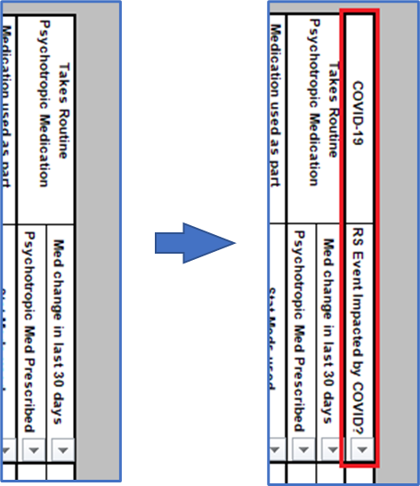
How to Convert to the New Provider Reactive Strategies Reporting Form
The updated Reactive Strategies Reporting form is the same as the previous version of the form with the addition of a column for indicating when a reactive strategy is related to COVID-19. Select all cells from the Area column (Column A) through the Med change in last 30 days column (Column Y) for all completed rows (see screenshot).

Slide 13
How to Convert to the New Provider Reactive Strategies Reporting Form
The updated Reactive Strategies Reporting form is the same as the previous version of the form with the addition of a column for indicating when a reactive strategy is related to COVID-19.
To move entries from the previous form to the current version:
Select all cells from the Area column (Column A) through the Med change in last 30 days column (Column Y) for all completed rows (see screenshot).
Copy (Ctrl+c)
Navigate to the current version of the report.
Click in cell A9.
Paste Values (123)

Slide 14
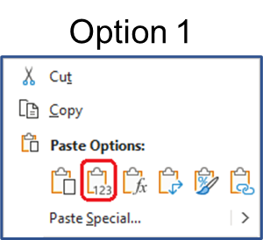
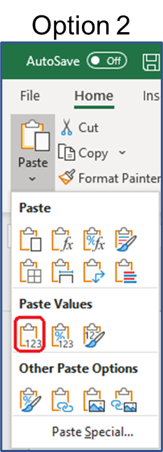
How to Convert to the New Provider Reactive Strategies Reporting Form
Paste Values (123)
Using mouse – option 1
Right click cell A9.
Left click the clipboard with the “123” overlapping (see screenshot).
Using mouse – option 2
Navigate to the Home tab of the ribbon.
Under “Paste” there is a “v” that indicates there are additional options, click on the “v.”
Under the subheading “Paste Values,” click on the clipboard with the “123” overlapping (see screenshot).
Using keyboard shortcut – Alt→h→v→v

Slide 15
How to Convert to the New Provider Reactive Strategies Reporting Form
The new form will contain all of the data from the original report (see screenshot).
You will need to complete the COVID column (Column Z).

Slide 16
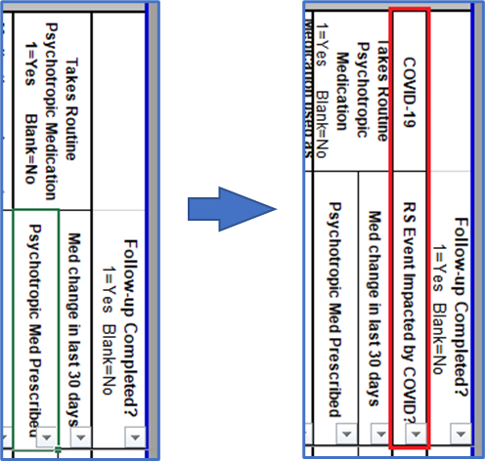
How to Convert to the APD Staff Reactive Strategies Reporting Form
The updated Reactive Strategies Reporting form is the same as the previous version of the form with the addition of a column for indicating when a reactive strategy is related to COVID-19, which appears between the psychotropic medication and follow-up sections (see screenshots below).

Slide 17
How to Convert to the APD Staff Reactive Strategies Reporting Form
To move entries from the previous form to the current version:
Select all cells from the Area column (Column A) through the Med change in last 30 days column (Column Y) for all completed rows (see screenshot).
Copy (Ctrl+c)
Navigate to the current version of the report.
Click in cell A9.
Paste Values (123)

Slide 18
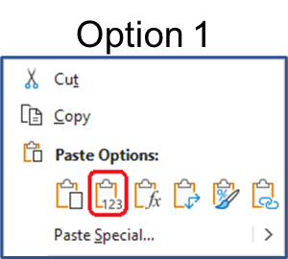
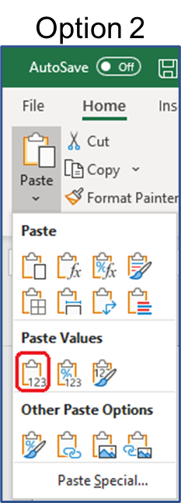
How to Convert to the New APD Staff Reactive Strategies Reporting Form
Paste Values (123)
Using mouse – option 1
Right click cell A9.
Left click the clipboard with the “123” overlapping (see screenshot).
Using mouse – option 2
Navigate to the Home tab of the ribbon.
Under “Paste” there is a “v” that indicates there are additional options, click on the “v.”
Under the subheading “Paste Values,” click on the clipboard with the “123” overlapping (see screenshot).
Using keyboard shortcut – Alt→h→v→v

Slide 19
How to Convert to the APD Staff Reactive Strategies Reporting Form
The new form will contain all of the data from the original report except the follow-up information (see screenshot). The follow-up information must be copied over separately.

Slide 20
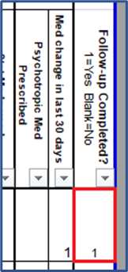
How to Convert to the APD Staff Reactive Strategies Reporting Form
To copy over the follow-up information, navigate back to the previous form.
Select all cells from the Follow-up column (Column Z) for all completed rows (see screenshot).
Copy

Slide 21
How to Convert to the APD Staff Reactive Strategies Reporting Form
Navigate back to the current version of the report.
Click in the relevant cell in column AA.
Paste Values
The new form will contain all of the data from the original report, (see screenshot). This will not contain information related to COVID-19, but your report will only contain information reported by the providers.

